Slide 1
Introduction to Deep Learning

Slide 2
Supervised Learning
Input(x)
Output (y)
Application
Home features
Price
Real Estate
Standard NN
Ad, user info
Click on ad? (0/1)
Online Advertising
Image
Object (1,…,1000)
Photo tagging
CNN
Audio
Text transcript
Speech recognition
RNN
English
Chinese
Machine translation
Image, Radar info
Position of other cars
Autonomous driving
Custom/ Hybrid

Slide 3
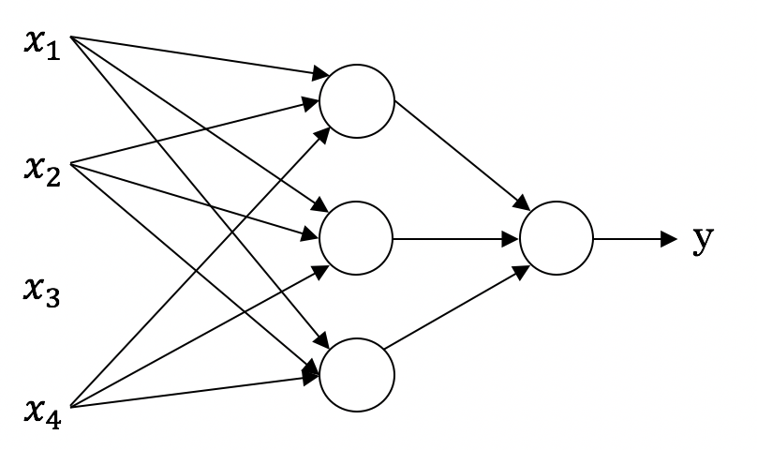
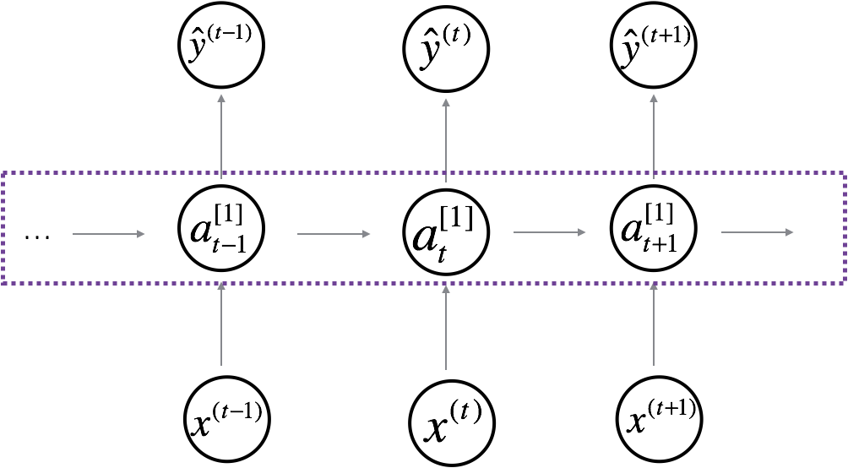
Neural Network examples
Standard NN
Convolutional NN
Recurrent NN
Neural Network Types

Slide 4

Supervised Learning
Structured Data
Unstructured Data
Size | #bedrooms | … | Price (1000$s)
2104 1600 2400 ⋮ 3000 | 3 3 3 ⋮ 4 |  | 400 330 369 ⋮ 540
Audio
Image
User Age | Ad Id | … | Click
41 80 18 ⋮ 27 | 93242 93287 87312 ⋮ 71244 |  | 1 0 1 ⋮ 1
Four scores and seven years ago…
Text

Slide 5
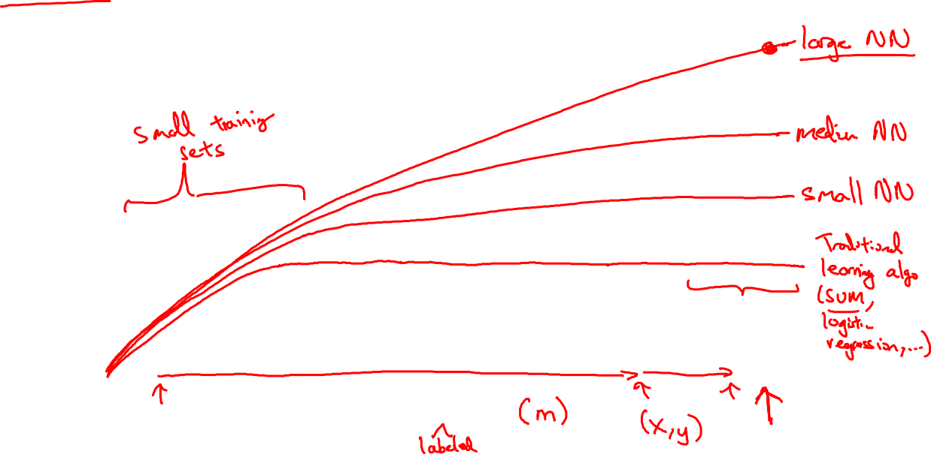
Scale drives deep learning progress
Performance
Amount of data

Slide 6

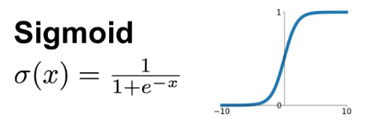
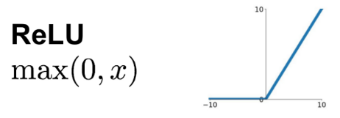
Scale drives deep learning progress
Idea
Data
Computation
Algorithms
Experiment
Code
For example

Slide 7
Neural Network Representation

Slide 8

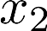
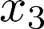
Logistic Regression (Notation)
$$h_{w}\left(x\right)$$

Slide 9
Neuron model: Logistic unit
$$x=\left[\begin{matrix}\begin{aligned}x_{0} \\ x_{1}\end{aligned} \\ x_{2} \\ x_{3}\end{matrix}\right]$$
w$=\left[\begin{matrix}\begin{aligned}w_{0} \\ w_{1}\end{aligned} \\ w_{2} \\ w_{3}\end{matrix}\right]$
$$x_{1}$$
$$x_{2}$$
$$σ(z)$$
$$a=\hat{y}$$
$$w^{T}x+b$$
$$z$$
$$a$$
$$x_{3}$$
$x_{0}$=1
$w_{0}$=b
$$x=\left[\begin{matrix}x_{1} \\ x_{2} \\ x_{3}\end{matrix}\right]$$
w$=\left[\begin{matrix}w_{1} \\ w_{2} \\ w_{3}\end{matrix}\right]$

Slide 10
Neural Network Representation
$$x_{1}$$
$$x_{1}$$
$$x_{2}$$
$$σ(z)$$
$$a=\hat{y}$$
$$x_{2}$$
$$\hat{y}$$
$$w^{T}x+b$$
$$z$$
$$a$$
$$x_{3}$$
$$x_{3}$$
$$z=w^{T}x+b$$
$$x_{1}$$
$$a=σ(z)$$
$$x_{2}$$
$$\hat{y}$$
$$x_{3}$$

Slide 11
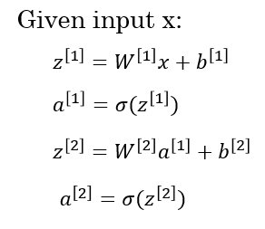
Neural Network Representation
$$a_{1}^{\left[1\right]}$$
$z_{1}^{\left[1\right]}=w_{1}^{{\left[1\right]T}^{ }}x+b_{1}^{[1]}, a_{ 1}^{[1]}=σ(z_{1}^{\left[1\right]}$)
$$x_{1}$$
$$a_{2}^{\left[1\right]}$$
$z_{2}^{\left[1\right]}=w_{2}^{{\left[1\right]T}^{ }}x+b_{2}^{[1]}, a_{ 2}^{[1]}=σ(z_{2}^{\left[1\right]}$)
$$x_{2}$$
$$\hat{y}$$
$$a_{3}^{\left[1\right]}$$
$z_{3}^{\left[1\right]}=w_{3}^{{\left[1\right]T}^{ }}x+b_{3}^{[1]}, a_{ 3}^{[1]}=σ(z_{3}^{\left[1\right]}$)
$$x_{3}$$
$$a_{4}^{\left[1\right]}$$
$$w_{1}^{{\left[1\right]}^{ }}=\left[\begin{matrix}w_{11}^{{\left[1\right]}^{ }} \\ w_{12}^{{\left[1\right]}^{ }} \\ w_{13}^{{\left[1\right]}^{ }}\end{matrix}\right]$$
$z_{4}^{\left[1\right]}=w_{4}^{{\left[1\right]T}^{ }}x+b_{4}^{[1]}, a_{ 4}^{[1]}=σ(z_{4}^{\left[1\right]}$)
$$W^{[1]}=\left[\begin{matrix}w_{11}^{{\left[1\right]}^{ }} & w_{12}^{{\left[1\right]}^{ }} & w_{13}^{{\left[1\right]}^{ }} \\ w_{21}^{{\left[1\right]}^{ }} & w_{22}^{{\left[1\right]}^{ }} & w_{23}^{{\left[1\right]}^{ }} \\ \begin{aligned}w_{31}^{{\left[1\right]}^{ }} \\ w_{41}^{{\left[1\right]}^{ }}\end{aligned} & \begin{aligned}w_{32}^{{\left[1\right]}^{ }} \\ w_{42}^{{\left[1\right]}^{ }}\end{aligned} & \begin{aligned}w_{33}^{{\left[1\right]}^{ }} \\ w_{43}^{{\left[1\right]}^{ }}\end{aligned}\end{matrix}\right]$$
$$b_{}^{{\left[1\right]}^{ }}=\left[\begin{matrix}b_{1}^{{\left[1\right]}^{ }} \\ b_{2}^{{\left[1\right]}^{ }} \\ \begin{aligned}b_{3}^{{\left[1\right]}^{ }} \\ b_{4}^{{\left[1\right]}^{ }}\end{aligned}\end{matrix}\right]$$
$$x=\left[\begin{matrix}x_{1} \\ x_{2} \\ x_{3}\end{matrix}\right]$$

Slide 12
Parameters $W^{[l]}$ and $b^{[l]}$
$$x_{1}$$
$$\hat{y}$$
$$x_{2}$$
$$z^{[1]}=W^{\left[1\right] }∗ x +b^{[1]}$$
$$W^{[l]}:{(n}^{\left[l\right] },n^{\left[l−1\right] })$$
(3,1)$\left(3,2\right) \left(2,1\right) (3,1)$
$\left(n^{\left[1\right]},1\right)$ $\left(n^{\left[1\right]},n^{\left[0\right]}\right)$ $\left(n^{\left[0\right]},1\right)$ $\left(n^{\left[1\right]},1\right)$
$$b^{[l]}:{(n}^{\left[l\right] },1)$$
$${dW}^{[l]}:{(n}^{\left[l\right] },n^{\left[l−1\right] })$$
$${db}^{[l]}:{(n}^{\left[l\right] },1)$$
$$z^{[2]}=W^{\left[2\right] }∗a^{\left[1\right]} +{ b}^{[2]}$$
(5,1)$\left(5,3\right) \left(3,1\right) (5,1)$

Slide 13
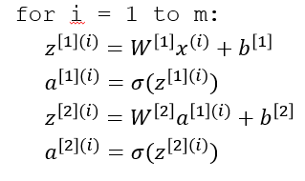
Vectorizing across multiple examples
$$z^{\left[1\right]}=W^{\left[1\right]}x+b^{\left[1\right]}$$
$$x_{1}$$
$$a^{\left[1\right]}=σ(z^{\left[1\right]})$$
$$x_{2}$$
$$\hat{y}$$
$$z^{\left[2\right]}=W^{\left[2\right]}a^{\left[1\right]}+b^{\left[2\right]}$$
$$x_{3}$$
$$a^{\left[2\right]}=σ(z^{\left[2\right]})$$
m – number of examples in the dataset

Slide 14
Vectorising across multiple examples
for i = 1 to m
$$x_{1}$$
$$z^{\left[1\right](i)}=W^{\left[1\right]}x^{(i)}+b^{\left[1\right]}$$
$$x_{2}$$
$$\hat{y}$$
$$x_{3}$$
$$a^{\left[1\right](i)}=σ(z^{\left[1\right]\left(i\right)})$$
$$z^{\left[2\right](i)}=W^{\left[2\right]}a^{\left[1\right](i)}+b^{\left[2\right]}$$
$$a^{\left[2\right](i)}=σ(z^{\left[2\right]\left(i\right)})$$
$$X=$$
$$x^{(1)}$$
$$x^{(2)}$$
…
$$x^{(m)}$$
$$Z^{\left[1\right]}=W^{\left[1\right]}X+b^{\left[1\right]}$$
$$A^{\left[1\right]}=σ(Z^{\left[1\right]})$$
$$Z^{\left[2\right]}=W^{\left[2\right]}A^{\left[1\right]}+b^{\left[2\right]}$$
$A^{[1]}=$
$$a^{[1](1)}$$
$$a^{[1](2)}$$
$$a^{[1](m)}$$
…
$$A^{\left[2\right]}=σ(Z^{\left[2\right]})$$

Slide 15
Vectorized implementation
$$x_{1}$$
$$\hat{y}$$
$$x_{2}$$
$$z^{[1]}=W^{\left[1\right] }∗ x +b^{[1]}$$
$$z^{[l]},a^{\left[l\right] }:{(n}^{\left[l\right] },1)$$
$\left(n^{\left[1\right]},1\right)$ $\left(n^{\left[1\right]},n^{\left[0\right]}\right)$ $\left(n^{\left[0\right]},1\right)$ $\left(n^{\left[1\right]},1\right)$
$$Z^{[l]},A^{\left[l\right] }:{(n}^{\left[l\right] },m)$$
$$Z^{[1]}=W^{\left[1\right] }∗ X +b^{[1]}$$
$l$=0$A^{\left[0\right] }=X :(n^{\left[0\right] }, m)$
$\left(n^{\left[1\right]},m\right)$ $\left(n^{\left[1\right]},n^{\left[0\right]}\right)$ $\left(n^{\left[0\right]},m\right)$ $\left(n^{\left[1\right]},1\right)$
$${dZ}^{[l]},{dA}^{\left[l\right] }:{(n}^{\left[l\right] },m)$$

Slide 16
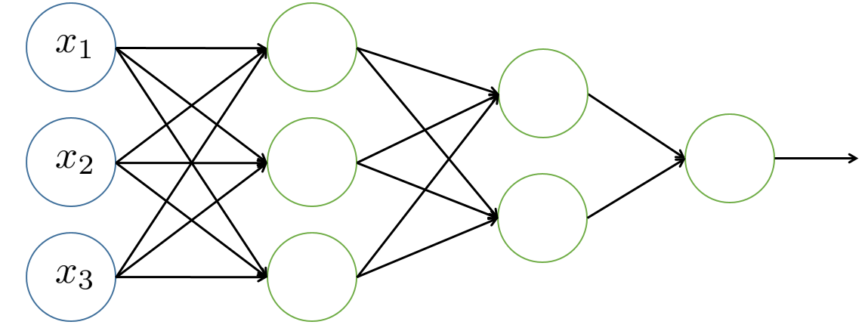
Forward propagation
$$Z^{[1]}=W^{[1]}X+b^{[1]}$$
$$A^{[1]}=g^{\left[1\right]}(Z^{\left[1\right]})$$
$$Z^{[2]}=W^{[2]}A^{[1]}+b^{[2]}$$
$$A^{[2]}=g^{\left[2\right]}(Z^{\left[2\right]})$$
$$h_{w}\left(x\right)$$
…
$$A^{[L]}=g^{\left[L\right]}\left(Z^{\left[L\right]}\right)=\hat{Y}$$

Slide 17


Slide 18
Why do you need non-linear
activation functions?

Slide 19
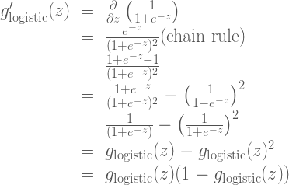
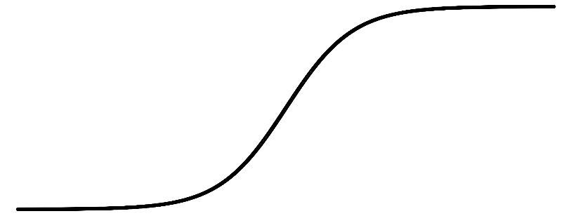
Derivatives of activation functions Sigmoid activation function
$$g(z)= \frac{1}{1+e^{−z}}$$
a
z

Slide 20
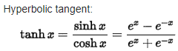
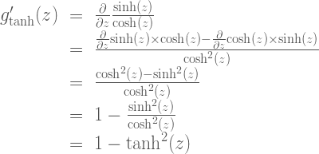
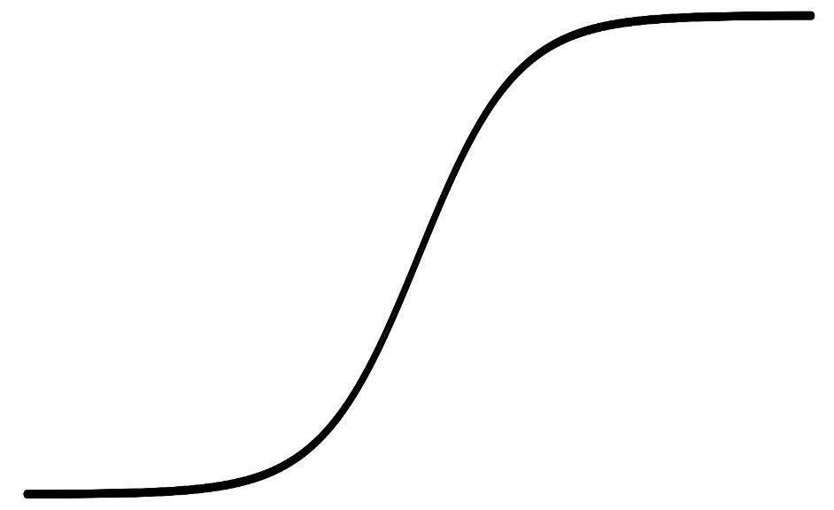
Tanh activation function
$$g(z)=tanh(z){ }$$
a
z

Slide 21
Derivative of ReLU and Leaky ReLU
a
a
z
z
ReLU
Leaky ReLU
$$g\left(z\right)=Max(0,z)$$
$$g^{′}\left(z\right)=\left\{\begin{aligned}0 if z<0 \\ 1 if z>0 \\ undefined if z=0\end{aligned}\right.$$
$$g\left(z\right)=Max(0,01 z,z)$$
$$g^{′}\left(z\right)=\left\{\begin{aligned}0,01 if z<0 \\ 1 if z>0 \\ undefined if z=0\end{aligned}\right.$$
For simplicity:
$$g\left(z\right)=Max(0,z)$$
$$g^{′}\left(z\right)=\left\{\begin{aligned}0 if z<0 \\ 1 if z≥0\end{aligned}\right.$$
$$g\left(z\right)=Max(0,01z,z)$$
$$g^{′}\left(z\right)=\left\{\begin{aligned}0,01 if z<0 \\ 1 if z≥0\end{aligned}\right.$$

Slide 22
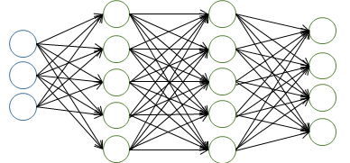
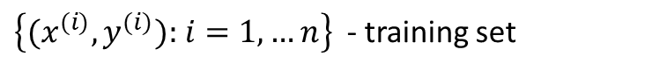
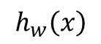
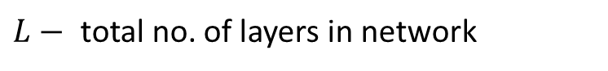
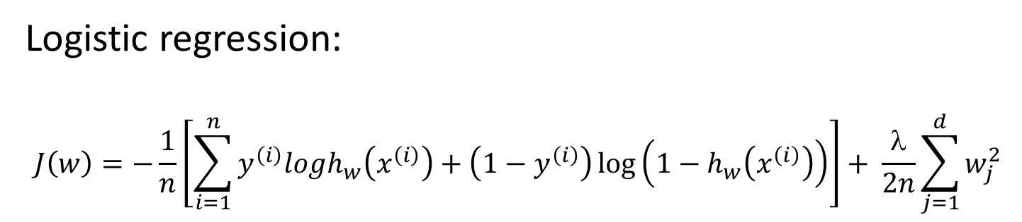
Cost function
Logistic regression:
$$J\left(w\right)=−\frac{1}{n}\left[\sum_{i=1}^{n}{y^{\left(i\right)}logh_{w}\left(x^{\left(i\right)}\right)}+\left(1−y^{\left(i\right)}\right)\log\left(1−h_{w}\left(x^{\left(i\right)}\right)\right)\right]+ \frac{λ}{2n}\sum_{j=1}^{d}{w_{j}^{2}}$$
$$h_{w}\left(x\right)$$
Neural networks:
$$J\left(w\right)=−\frac{1}{n}\left[\sum_{i=1}^{n}{\sum_{k=1}^{K}{y_{k}^{(i)}log{\left(h_{w}\left(x^{\left(i\right)}\right)\right)}_{i}}}+\left(1−y_{k}^{(i)}\right)\log\left(1−{\left(h_{w}\left(x^{\left(i\right)}\right)\right)}_{k}\right)\right]+ \frac{λ}{2n}\sum_{l=1}^{L−1}{\sum_{i=1}^{s_{l}}{\sum_{j=1}^{s_{l+1}}{{(w_{ji}^{\left(l\right)})}^{2}}}}$$
$\left\{{(x}^{(i)},y^{(i)})\text{: }i=1,…n\right\}$ - training set
$L−$ total no. of layers in network
$s_{l}−$no. of units (not counting bias unit) in layer

Slide 23
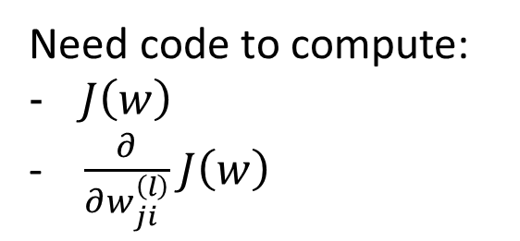
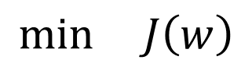
Gradient Descent algorithm
$$J\left(w\right)=−\frac{1}{n}\left[\sum_{i=1}^{n}{\sum_{k=1}^{K}{y_{k}^{(i)}log{\left(h_{w}\left(x^{\left(i\right)}\right)\right)}_{i}}}+\left(1−y_{k}^{(i)}\right)\log\left(1−{\left(h_{w}\left(x^{\left(i\right)}\right)\right)}_{k}\right)\right]+ \frac{λ}{2n}\sum_{l=1}^{L−1}{\sum_{i=1}^{s_{l}}{\sum_{j=1}^{s_{l+1}}{{(w_{ji}^{\left(l\right)})}^{2}}}}$$
$$\min{ J\left(w\right)}$$
Need code to compute:
$J\left(w\right)$
- $\frac{∂}{∂w_{ji}^{\left(l\right)}}J\left(w\right)$

Slide 24
Neural Network Training

Slide 25
Derivatives with a Computation Graph

Slide 26

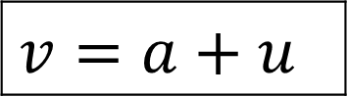
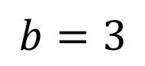
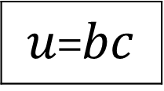
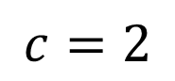
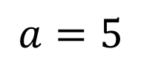
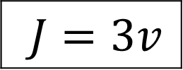
Computation Graph
$J=3(a+bc)$
$$a=5$$
11
33
$$b=3$$
6
$$v=a+u$$
$J=3v$
$u$=$bc$
$$c=2$$

Slide 27
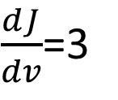
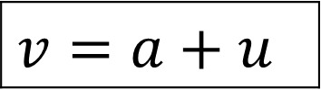
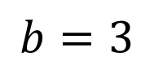
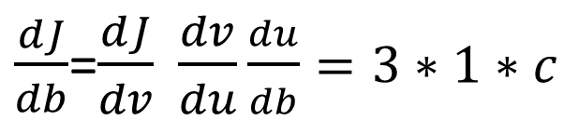
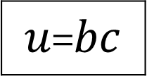
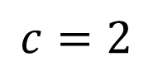
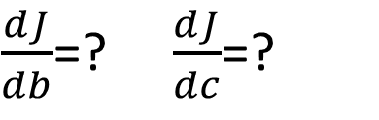
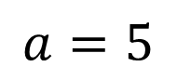
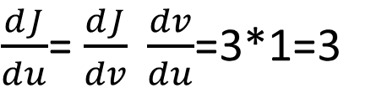
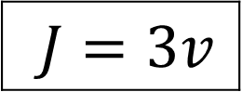
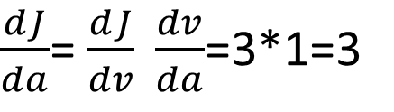
Derivatives with a Computation Graph
$$a=5$$
11
33
$$b=3$$
6
$$v=a+u$$
$J=3v$
$u$=$bc$
$$c=2$$
$\frac{dJ}{dv}$=3
$\frac{dJ}{da}$= $\frac{dJ}{dv} \frac{dv}{da}$=3*1=3
$\frac{dJ}{du}$= $\frac{dJ}{dv} \frac{dv}{du}$=3*1=3
$\frac{dJ}{db}$=$\frac{dJ}{dv} \frac{dv}{du}\frac{du}{db}=3∗1∗c$
$\frac{dJ}{db}$=? $\frac{dJ}{dc}$=?

Slide 28
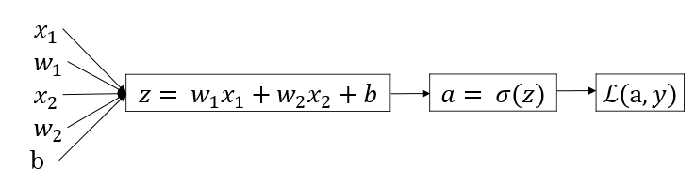
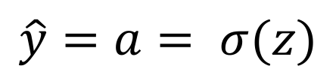
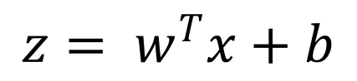
Logistic regression derivatives
$$z= w^{T}x+b$$
$$\hat{y}=a= σ(z)$$
$$ℒ\left(a,y\right)=−(y\log{(a)+(1−y)\log{(1−a))}}$$

Slide 29
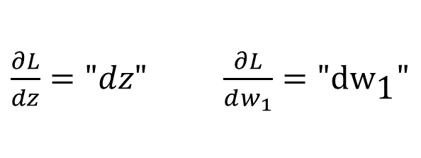
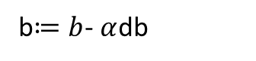
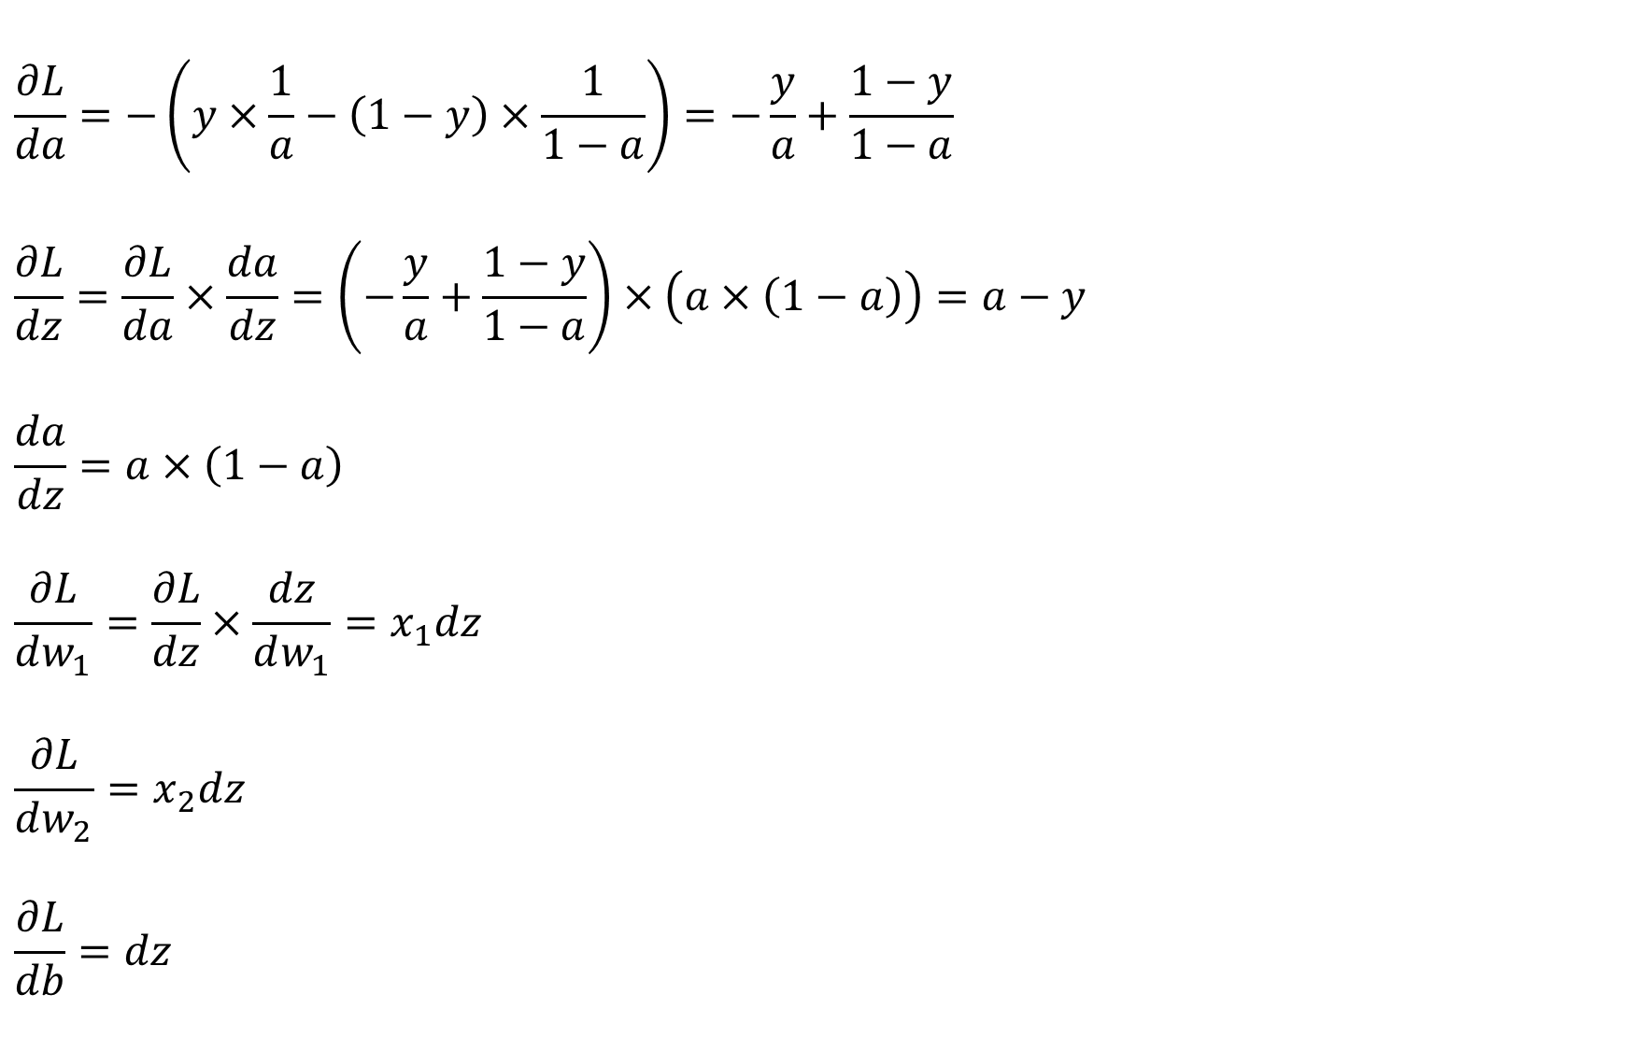
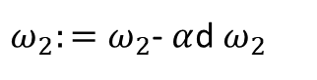
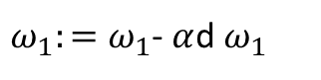
$$\frac{∂L}{da}=−\left(y×\frac{1}{a}−\left(1−y\right)×\frac{1}{1−a}\right)=−\frac{y}{a}+\frac{1−y}{1−a}$$
$$\frac{∂L}{dz}=\frac{∂L}{da}×\frac{da}{dz}=\left(−\frac{y}{a}+\frac{1−y}{1−a}\right)×\left(a×\left(1−a\right)\right)=a−y$$
$$\frac{da}{dz}=a×\left(1−a\right)$$
$$\frac{∂L}{dw_{1}}=\frac{∂L}{dz}×\frac{dz}{dw_{1}}=x_{1}dz$$
$$\frac{∂L}{dw_{2}}=x_{2}dz$$
$$\frac{∂L}{db}=dz$$
$\frac{∂L}{dz}="dz"$ $\frac{∂L}{dw_{1}}=\text{"}\text{d}{\text{w}}_{\text{1}}\text{"}$
$ω_{1}:=ω_{1}$- $α$d $ω_{1}$
$ω_{2}:=ω_{2}$- $α$d $ω_{2}$
b$≔b$- $α$db

Slide 30
Forward and Backward propagation
$${dZ}^{[L]}=A^{[L]}−Y$$
$$Z^{[1]}=W^{[1]}X+b^{[1]}$$
$$dW^{[L]}=\frac{1}{m}dZ^{\left[L\right]}A^{{\left[L\right]}^{T}}$$
$$A^{[1]}=g^{\left[1\right]}(Z^{\left[1\right]})$$
$$db^{[L]}=\frac{1}{m}np. sum(dZ^{\left[L\right]},axis=1, keepdims=True)$$
$$Z^{[2]}=W^{[2]}A^{[1]}+b^{[2]}$$
$$A^{[2]}=g^{\left[2\right]}(Z^{\left[2\right]})$$
$${dZ}^{[L−1]}=dW^{{\left[L\right]}^{T}}dZ^{\left[L\right]}{g^{′}}^{\left[L\right]}(Z^{\left[L−1\right]})$$
…
…
$$A^{[L]}=g^{\left[L\right]}\left(Z^{\left[L\right]}\right)=\hat{Y}$$
$${dZ}^{[1]}=dW^{{\left[L\right]}^{T}}dZ^{\left[2\right]}{g^{′}}^{\left[1\right]}(Z^{\left[1\right]})$$
$$dW^{[1]}=\frac{1}{m}dZ^{\left[1\right]}A^{{\left[1\right]}^{T}}$$
$$db^{[1]}=\frac{1}{m}np. sum(dZ^{\left[1\right]},axis=1, keepdims=True)$$

Slide 31
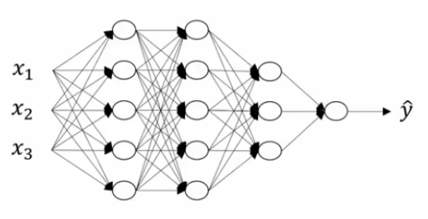
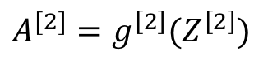
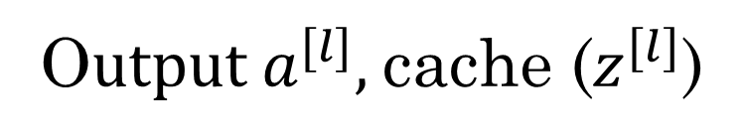





Forward propagation for layer l
$$Z^{[1]}=W^{[1]}X+b^{[1]}$$
$$A^{[1]}=g^{\left[1\right]}(Z^{\left[1\right]})$$
$$Z^{[2]}=W^{[2]}A^{[1]}+b^{[2]}$$
$$A^{[2]}=g^{\left[2\right]}(Z^{\left[2\right]})$$
…
$$A^{[L]}=g^{\left[L\right]}\left(Z^{\left[L\right]}\right)=\hat{Y}$$
Input $a^{[l−1]}$
O$utput a^{[l]},$cache ($z^{[l]}$)

Slide 32









Backward propagation for layer l
$${dZ}^{[L]}=A^{[L]}−Y$$
$$dW^{[L]}=\frac{1}{m}dZ^{\left[L\right]}A^{{\left[L\right]}^{T}}$$
$$db^{[L]}=\frac{1}{m}np. sum(dZ^{\left[L\right]},axis=1, keepdims=True)$$
$${dZ}^{[L−1]}=dW^{{\left[L\right]}^{T}}dZ^{\left[L\right]}{g^{′}}^{\left[L\right]}(Z^{\left[L−1\right]})$$
…
$${dZ}^{[1]}=dW^{{\left[L\right]}^{T}}dZ^{\left[2\right]}{g^{′}}^{\left[1\right]}(Z^{\left[1\right]})$$
$$dW^{[1]}=\frac{1}{m}dZ^{\left[1\right]}A^{{\left[1\right]}^{T}}$$
Input ${da}^{[l]}$
$$db^{[1]}=\frac{1}{m}np. sum(dZ^{\left[1\right]},axis=1, keepdims=True)$$
O$utput {da}^{\left[l−1\right]},dW^{\left[l\right]},db^{[l]}$

Slide 33

Forward and backward propagation
For example the first activation functions could be ReLU and the last one
Could be sigmoid
Align left/vertical will mess up the equations here

Slide 34
Gradient checking

Slide 35










Numerical estimation of gradients

Slide 36
Gradient check for a neural network
Take $W^{\left[1\right]},b^{[1]},…,W^{\left[L\right]},b^{\left[L\right]}$ and reshape into a big vector $θ.$
Take ${dW}^{\left[1\right]},{db}^{[1]},…,{dW}^{\left[L\right]},{db}^{\left[L\right]}$ and reshape into a big vector $dθ.$

Slide 37




Gradient checking (Grad check)
$$J\left(θ\right)=J(θ_{1},θ_{2},θ_{3},…)$$
for each $i$:
$dθ_{approx}^{\left[i\right]}=\frac{J\left(θ_{1},θ_{2}…,θ_{i}+ε,…\right)−J\left(θ_{1},θ_{2}…,θ_{i}−ε,…\right)}{2ε}$
$≈dθ\left[i\right]=\frac{∂J}{∂θ_{i}}$
Check: ${\left\|dθ_{approx}−dθ \right\|}_{2}$
___________________________
${\left\|dθ_{approx}\right\|}_{2}+{\left\|dθ\right\|}_{2}$
$$dθ_{approx}≈dθ$$
$≈{10}^{−7}$ - great
${10}^{−5}$ - normal
${10}^{−3}$ - worry

Slide 38
Random initialization
Before we start training the neural network, we must select an initial value for these parameters. We do not use the value zero as the initial value. This is because the output of the first layer will always be the same.
This will cause problems later on when we try to update these parameters (i.e., the gradients will all be the same). The solution is to randomly initialize the parameters to small values (e.g., normally distributed around zero;
What if we had initialized all parameters to be the same non-zero value?
Each element of the activation vector a[1] will be the same (because W[1] contains all the same values). This behavior will occur at all layers of the neural network. As a result, when we compute the gradient, all neurons in a layer will be equally responsible for anything contributed to the final loss. We call this property symmetry. This means each neuron (within a layer) will receive the exact same gradient update value (i.e., all neurons will learn the same thing).

Slide 39

Random initialization

Slide 40

Putting it together. Training a neural network
Pick a network architecture (connectivity pattern between neurons)
No. of input units: Dimension of features
No. output units: Number of classes

Slide 41

Training a neural network
Randomly initialize weights
Implement forward propagation
Implement code to compute cost function J(w)
Implement backprop to compute partial derivatives $\frac{∂}{∂w_{ji}^{\left(l\right)}}J\left(w\right)$
Use gradient checking to compare $\frac{∂}{∂w_{ji}^{\left(l\right)}}J\left(w\right)$ computed using backpropagation vs. using numerical estimate of gradient of J(w).
Use gradient descent or advanced optimization method with backpropagation to try to minimize J(w) as a function of parameters

Slide 42




Gradient descent is a first-order iterative optimization algorithm for finding the local minimum of a function.
$$J\left(w_{0}{,w}_{1}\right)$$
$$w_{1}$$
$$w_{0}$$

Slide 43

$$J\left(w_{0}{,w}_{1}\right)$$
$$w_{1}$$
$$w_{0}$$

Slide 44


Slide 45




Intuition about deep representation
$$\hat{y}$$

Slide 46

What are hyperparameters?
Parameters: $W^{\left[1\right]} ,{ b}^{\left[1\right] }, W^{\left[2\right]} ,b^{\left[2\right] },W^{\left[3\right] }, b^{\left[3\right] }…$
Hyperparameters: learning rate
# iterations
# hidden layers
# hidden units
# choice of activation function
minibatch size,
regularization parameter

Slide 47
Applied deep learning is a very empirical process
Idea
Experiment
Code

Slide 48
Reading material:
Deep Learning. Andrew Ng. http://cs229.stanford.edu/notes2019fall/cs229-notes-deep_learning.pdf
Neural network models. https://scikit-learn.org/stable/modules/neural_networks_supervised.html

